Slide 1
ME 439 - Final Project
Trevor Wallis, Joshua Ho, Vijay Shah, Shardul Shrikhande, Hongyuan Qi, Matthew Dudzic
Notes:
Hongyuan

Slide 2
Project Goals
2 mobile robots
Maze solving (wall following)
Recognition (camera and Aruco code)
Communication
Notes:
Hongyuan

Slide 3
Ultrasonic Sensor Calibration
Wall distances range from 0.1-0.3 meters
Ultrasonic sensor analog ranges between 10-150
More reliable to use analog ultrasonic sensor data to perform distance measurements
Fluctuations in analog data did not throw robot off course as much
Notes:
Vijay

Slide 4
Wall Following - Logic
Notes:
Trevor

Slide 5
Waypoint Seeking
Sensor information gathered
Waypoint determined
Add neighboring points for optimizing the path back
Move to waypoint
Repeat
Notes:
Josh

Slide 6
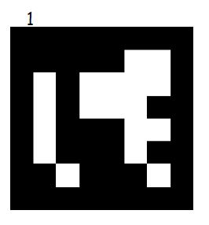

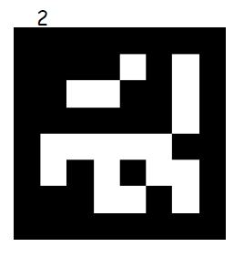
Recognition
Cameras look for Aruco code mounted on other robot
Robots programmed to stop when Aruco code is seen
Notes:
Matt

Slide 7
Future Work
Communication between robots - goal not implemented
Reverse waypoints to solve maze - goal not implemented
Implement LiDAR or other sensor to use in more complex terrain
Implement more than 2 robots using communication for more exploration
Notes:
Shardul
Serial Peripheral Interface :- Full Duplex Chip to Chip communication interface Compatible with Microwire Master-Slave bus with only one master
Wireless Communication Mechanisms :- Zigbee Designed for low power, low data rate sensor/control network applications speed 20Kbps to 250 Kbps Range – 10 m to 75 m Robust structure improves reception in difficult conditions Frame Check Sequence (FCS) validates error-free data. Star or mesh networks topology will be used for communication between 2 or more robots.

